Slide 1
Indoor plantation as a sources of recreation and a source of income
Date of presentation – 21 August 2021

Slide 2
Submitted to :
Course Instructor : Syeda Shabnam Mahmud
Depertment : Depertment of English
Course Title : Composition and Communication Skill
Course Code : ENG102
Section - 13

Slide 3



Submitted by :
Name :Nazat Amin Khan Depertment : Civil Engineering Roll: 2020-2-22-024
Name : Anika Mobashera Depertment : Computer Science and Engineering Roll : 2021-1-60-130
Name : Jannatul Ferdous Anika Sheikh Depertment : Electrical and Electronics Engineering Roll : 2020-2-80-027

Slide 4
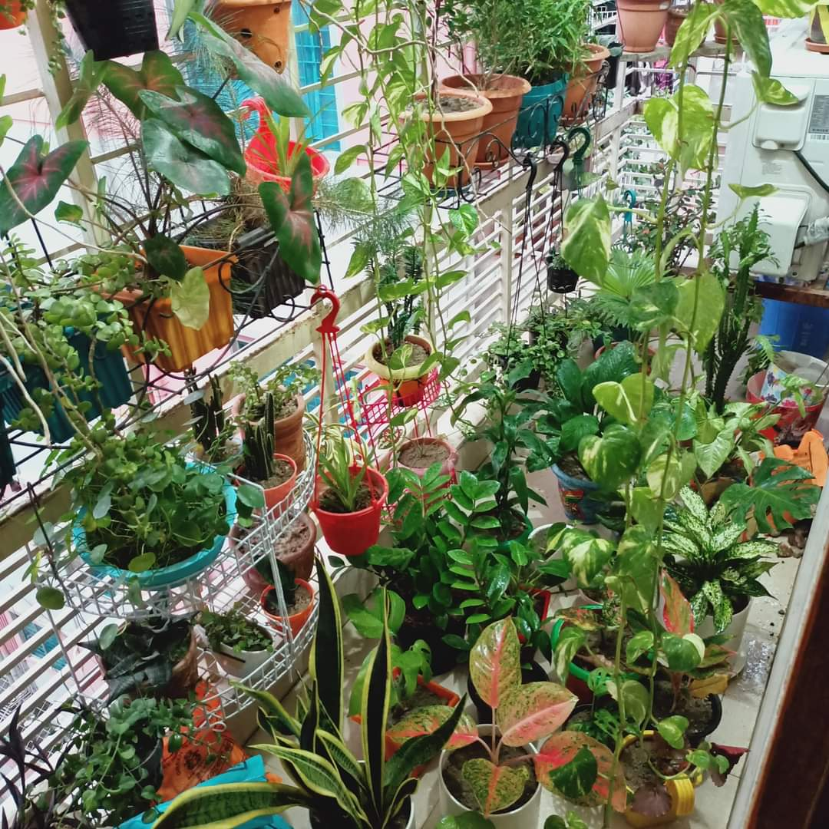
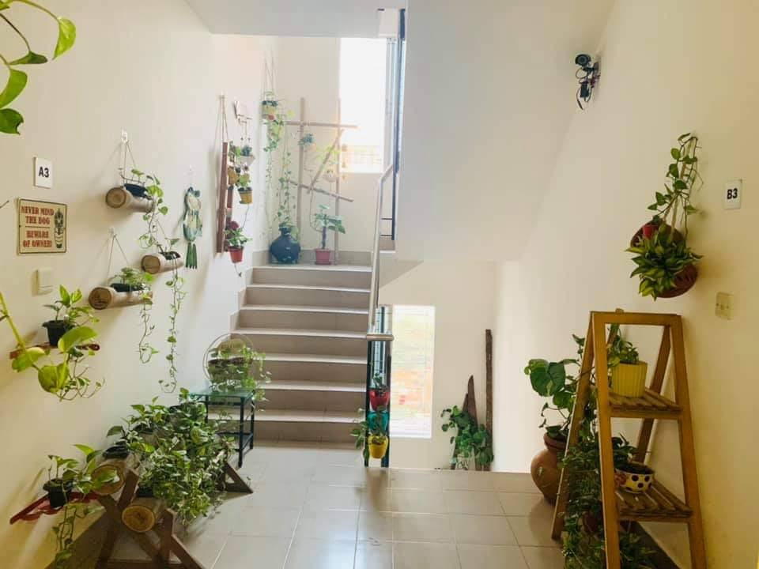
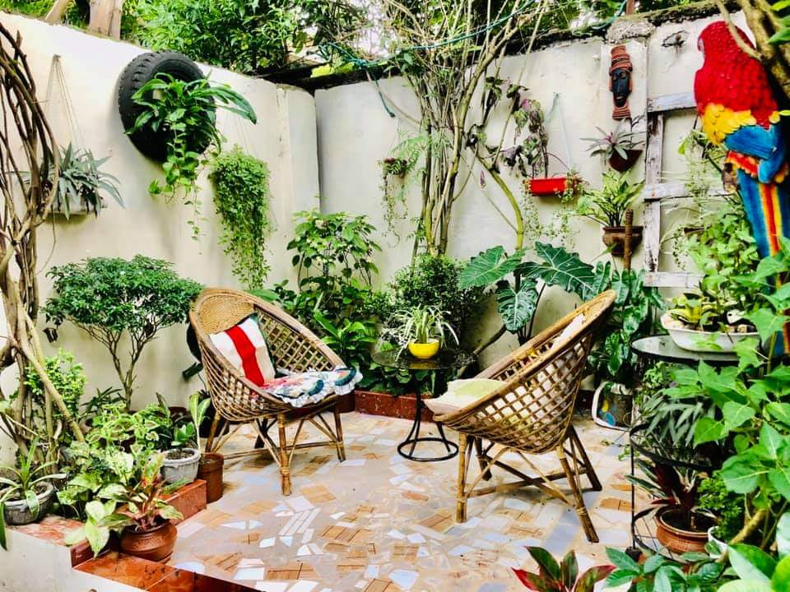
Introduction::
Indoor plantation is a kind of plantation that is cultivated by people at indoors in places. People do this as a hobby, to keep themselves busy, as a medium of recreation and as a purpose of income. Homesick people and housewives are the main to introduce this new era of earning.

Slide 5
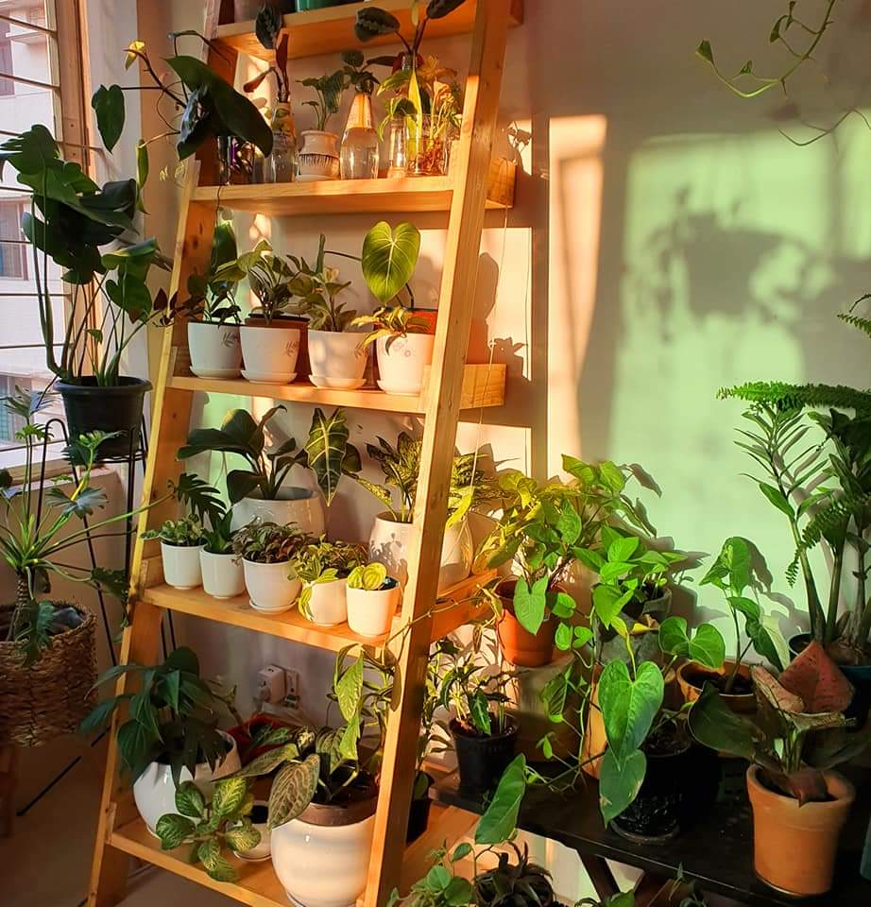
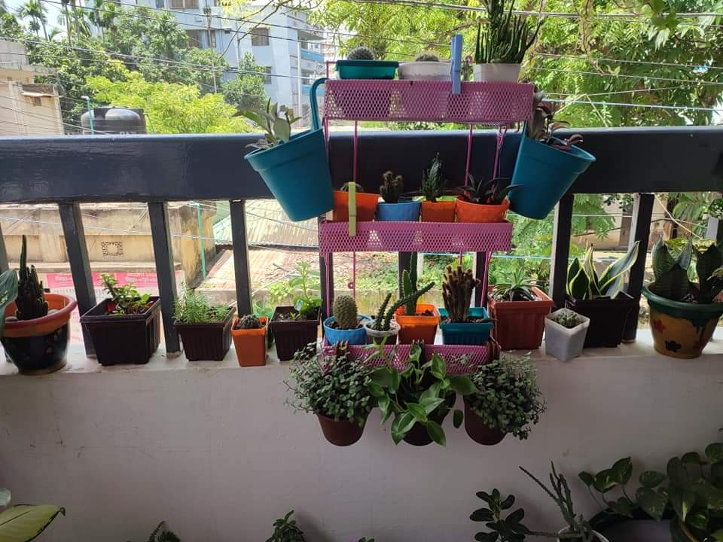
Justifying of choosing the topic:
Good for environment ‌Indoor work
Way of recreation ‌Helps economically

Slide 6
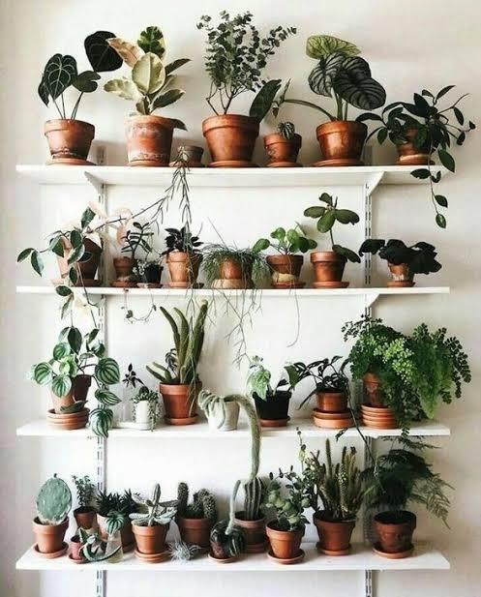

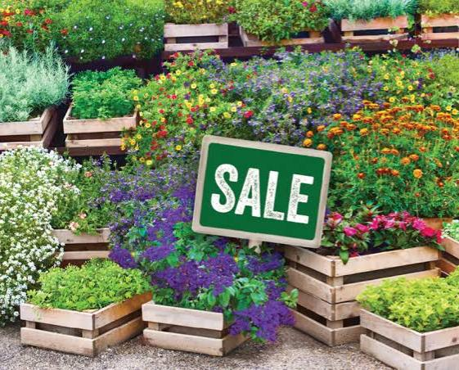
Reserch Question :
‌How can anybody profit economically from indoor plants? ‌How can indoor plants reduce psychological stress and can work as a source of recreation?

Slide 7
Literature Review :
Psychological restoration Work with plants
https://scholar.google.com/scholar?cluster=10785513035961987999&hl=en&as_sdt=0,5&scioq=indoor+plants++#:~:text=Bringslimark%2C%20Tina%2C%20Terry%20Hartig%2C%20and%20Grete%20G.%20Patil.%20%22The%20psychological%20benefits%20of%20indoor%20plants%3A%20A%20critical%20review%20of%20the%20experimental%20literature.%22%20Journal%20of%20Environmental%20Psychology%2029.4%20(2009)%3A%20422-433.
Financial resources Low income settelments
https://scholar.google.com/scholar?hl=en&as_sdt=0%2C5&q=indoor+plants+for+income+sources&oq=indoor+plants+for+income+source#:~:text=MLA-,Usavagovitwong%2C%20Nattawut.%20%22IMPROVING%20INDOOR%20ENVIRONMENTS%20FOR%20LOW-INCOME%20SETTLEMENTS.%22%20(2003).,-APA
Window with view of nature Enjoy the environment
https://scholar.google.com/scholar?hl=en&as_sdt=0%2C5&q=indoor+plants+for+recreation&btnG=#:~:text=Chang%2C%20Chen-Yen%2C%20and%20Ping-Kun%20Chen.%20%22Human%20response%20to%20window%20views%20and%20indoor%20plants%20in%20the%20workplace.%22%20HortScience%2040.5%20(2005)%3A%201354-1359

Slide 8
Method :
Qualitative and Quantitative.
Vanue.
Participants.
Interview Questions.
Survey Questions.

Slide 9

A. Qualitative and Quantitative :
Qualitative method
Quantitative method
Mixed method approach
Primary data source
Secondary Data source

Slide 10

B. Vanue
Phone call
Messenger
E-mail

Slide 11
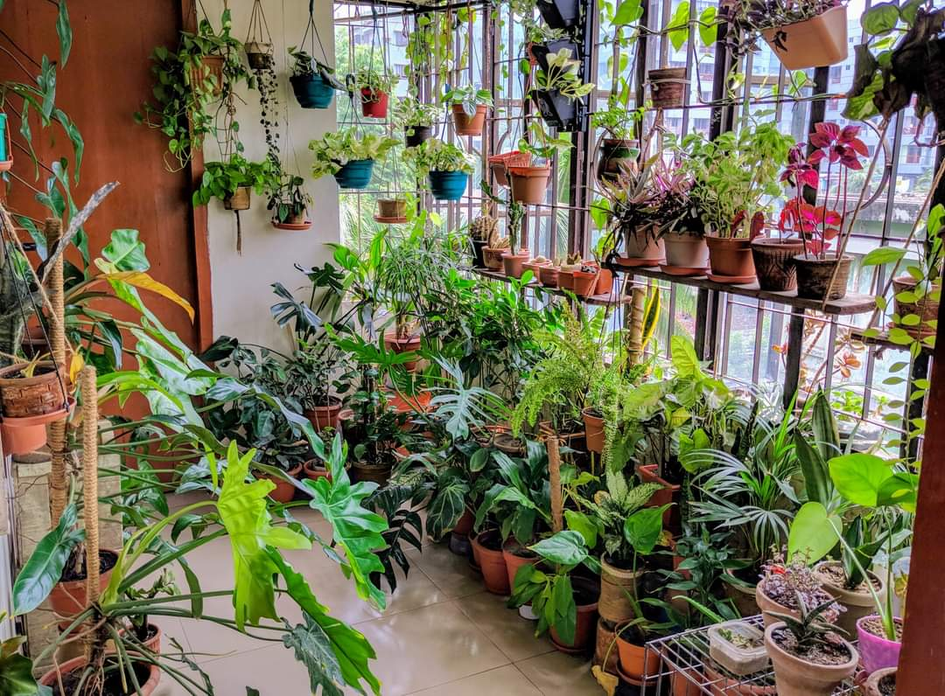
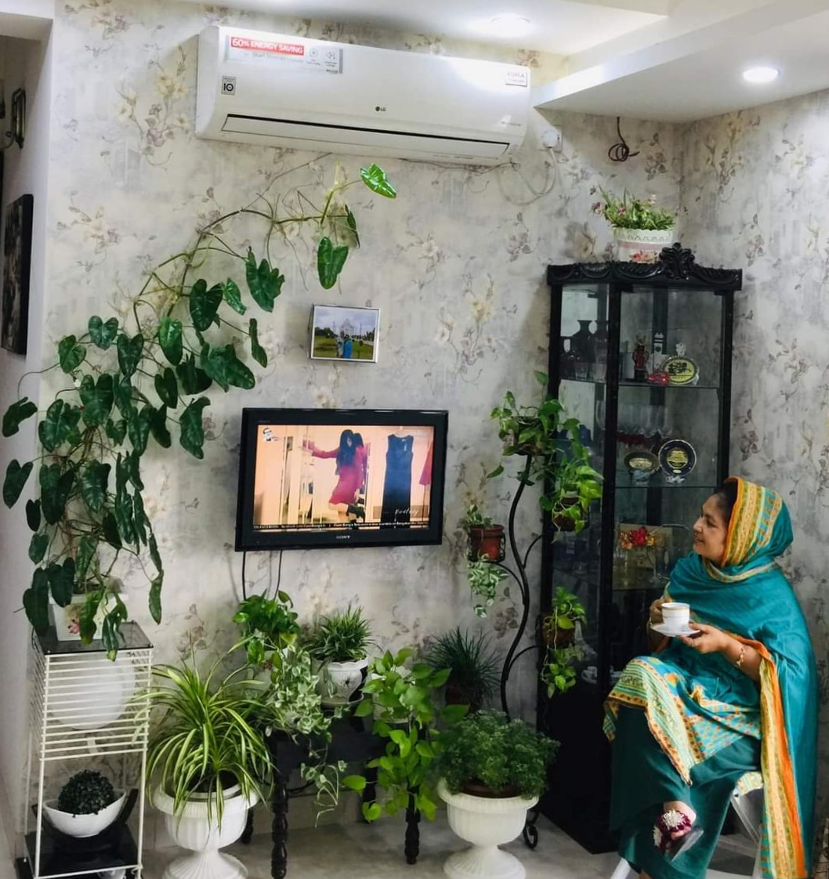
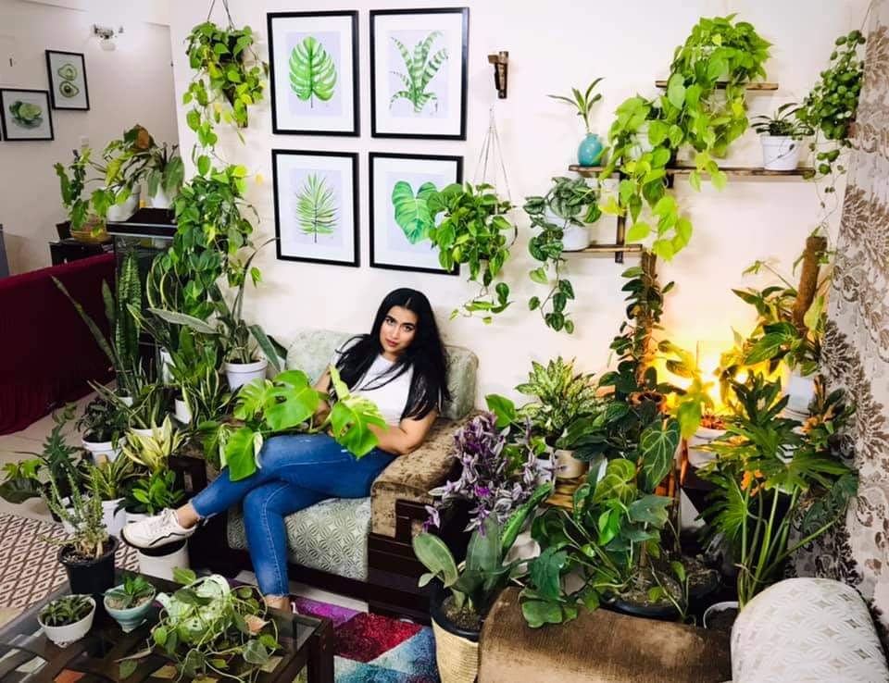
C. Participants :
1.
Name : Muntasir Ahmed Abbas
Age : 23
Profession : Student of L.L.B. In Dhaka University and
of Facebook group“Indoor Plants Bangladesh“
Location : Santinogor, Dhaka
2.
Name : Nazma Begum
Age 55
Profession : House wife
Location : Tejgaon, Dhaka
3.
Name Farhana Karim
Age : 34
Profession : Gurdren Business and Teacher
Location : Khilgaon,Dhaka

Slide 12
D. Interview Questions :
Why did you start an indoor plantation? ‌What motivated you to do indoor plantation?
How do you feel when you see your plants? ‌What types of trees do you have? ‌How do you manage or take care of them as they have individual needs?
‌How costly it is to maintain indoor plants? ‌How you getting economically benefitted with these? Do you face any difficultly for indoor plantation? What you do when plants become sick? How to start an indoor plantation? How can we create others interest to plant trees?

Slide 13
E. Survey Questions
Name-
Age-
Sex-
Q) Does your famoly support you in indoor plantation ? Ans- Q)How do you feel when you see your plants? Ans-
Q) How costly it it to maintain indoor plantation?
a)Very costly b) medium costly c) not much costly
Q) What type of plants do you have?
Ans-
Q) Your future plan about indoor plantation?
Ans-

Slide 14
Findings :
Interviewe Answer.
B. Survey Graph / Result.

Slide 15
A. Interview Answer :
We took three people‘s interview. All of their interview answer were total similar. We added a link below. There we added some screen short of their answer.
https://drive.google.com/folderview?id=1KIG71ONJWWikiuLolVAqyxUGYeSsH

Slide 16
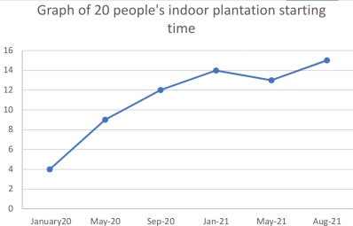
B. Survey Graph / Result :
We talked with our neighbours, friends and relatives about indoor plantation. After talking about indoor plantation with 20 people, we came to know When did they started indoor plantation. We presented it in the graph.

Slide 17
Discussion / Analysis :
After completing the research we came to know several things about indoor plantation. Our main focus were human comfort, economial help and recreation. Indoor plantation is good for human from all praspectively. It is becoming popular nowadays as a great source of income. We came to know about their starting time, motivation, take care, cost, economical benefit and suggestions.

Slide 18

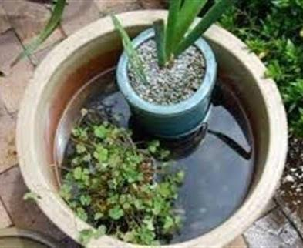
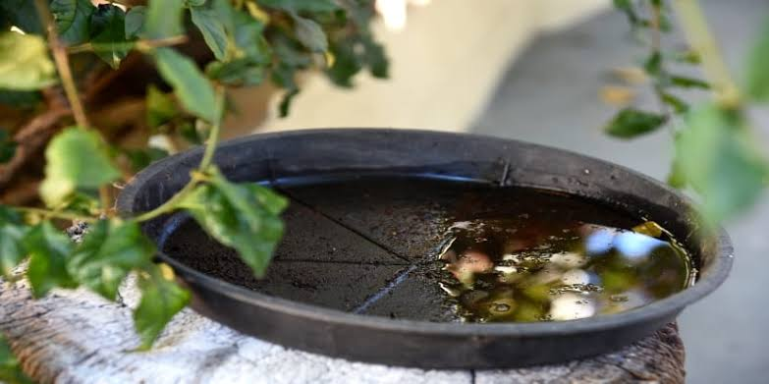
Conclusion :
In research, it has been observed that indoor plantation can be beneficial in many ways and also it is good for environment. Furthermore, our study and results indicated that indoor plants are a source of recreation and income.
Advantage
Disadvantage
Future suggestions

Slide 19

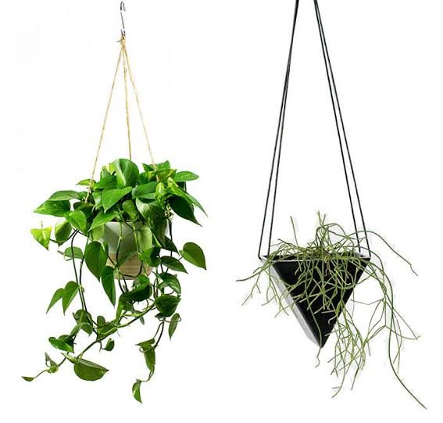
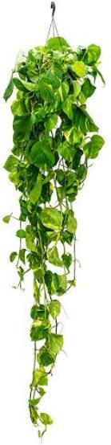


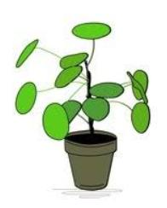

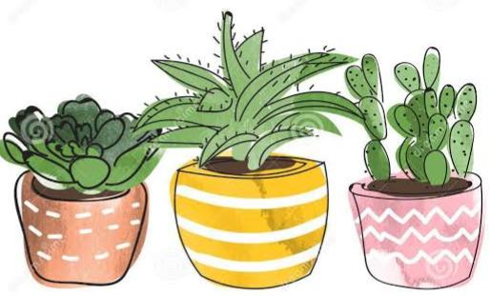
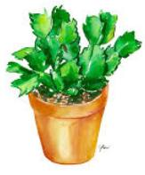

Thank You

